Slide 1
Data Mining:
Concepts and Techniques
(3rd ed.)
— Chapter 3 —
Jiawei Han, Micheline Kamber, and Jian Pei
University of Illinois at Urbana-Champaign &
Simon Fraser University
©2011 Han, Kamber & Pei. All rights reserved.

Slide 2
Chapter 3: Data Preprocessing
Data Preprocessing: An Overview
  Data Quality
  Major Tasks in Data Preprocessing
Data Cleaning
Data Integration
Data Reduction
Data Transformation and Data Discretization
Summary

Slide 3
Data Quality: Why Preprocess the Data?
Measures for data quality: A multidimensional view
  Accuracy: correct or wrong, accurate or not
  Completeness: not recorded, unavailable, …
  Consistency: some modified but some not, dangling, …
  Timeliness: timely update?
  Believability: how trustable the data are correct?
  Interpretability: how easily the data can be understood?

Slide 4
Major Tasks in Data Preprocessing
Data cleaning
  Fill in missing values, smooth noisy data, identify or remove outliers, and resolve inconsistencies
Data integration
  Integration of multiple databases, data cubes, or files
Data reduction
  Dimensionality reduction
  Numerosity reduction
  Data compression
Data transformation and data discretization
  Normalization
  Concept hierarchy generation

Slide 5
Chapter 3: Data Preprocessing
Data Preprocessing: An Overview
  Data Quality
  Major Tasks in Data Preprocessing
Data Cleaning
Data Integration
Data Reduction
Data Transformation and Data Discretization
Summary

Slide 6
Data Cleaning
Data in the Real World Is Dirty: Lots of potentially incorrect data, e.g., instrument faulty, human or computer error, transmission error
  incomplete: lacking attribute values, lacking certain attributes of interest, or containing only aggregate data
    e.g., Occupation=“ ” (missing data)
  noisy: containing noise, errors, or outliers
    e.g., Salary=“−10” (an error)
  inconsistent: containing discrepancies in codes or names, e.g.,
    Age=“42”, Birthday=“03/07/2010”
    Was rating “1, 2, 3”, now rating “A, B, C”
    discrepancy between duplicate records
  Intentional (e.g., disguised missing data)
    Jan. 1 as everyone’s birthday?

Slide 7
Incomplete (Missing) Data
Data is not always available
  E.g., many tuples have no recorded value for several attributes, such as customer income in sales data
Missing data may be due to
  equipment malfunction
  inconsistent with other recorded data and thus deleted
  data not entered due to misunderstanding
  certain data may not be considered important at the time of entry
  not register history or changes of the data
Missing data may need to be inferred

Slide 8
How to Handle Missing Data?
Ignore the tuple: usually done when class label is missing (when doing classification)—not effective when the % of missing values per attribute varies considerably
Fill in the missing value manually: tedious + infeasible?
Fill in it automatically with
  a global constant : e.g., “unknown”, a new class?!
  the attribute mean
  the attribute mean for all samples belonging to the same class: smarter
  the most probable value: inference-based such as Bayesian formula or decision tree

Slide 9
How to Handle Missing Data?
Many methods of estimating the missing values
  Mean, median, and modus value of measurements
  Expected value based on regression
  Expected value based on E-M algorithm
  Expected value based on k-NN
  Classification methods ==> ignore missing values
    Bayesian
    Decision Tree

Slide 10
Noisy Data
Noise: random error or variance in a measured variable
Incorrect attribute values may be due to
  faulty data collection instruments
  data entry problems
  data transmission problems
  technology limitation
  inconsistency in naming convention
Other data problems which require data cleaning
  duplicate records
  incomplete data
  inconsistent data

Slide 11
How to Handle Noisy Data?
Binning
  first sort data and partition into (equal-frequency) bins
  then one can smooth by bin means, smooth by bin median, smooth by bin boundaries, etc.
Regression
  smooth by fitting the data into regression functions
Clustering
  detect and remove outliers
Combined computer and human inspection
  detect suspicious values and check by human (e.g., deal with possible outliers)

Slide 12
Simple Discretization Methods: Binning
Equal-width (distance) partitioning:
  It divides the range into N intervals of equal size: uniform grid
  if A and B are the lowest and highest values of the attribute, the width of intervals will be: W = (B-A)/N.
  The most straightforward
  But outliers may dominate presentation
  Skewed data is not handled well.
Equal-depth (frequency) partitioning:
  It divides the range into N intervals, each containing approximately same number of samples
  Good data scaling
  Managing categorical attributes can be tricky.

Slide 13
Binning Methods for Data Smoothing
* Sorted data for price (in dollars): 4, 8, 9, 15, 21, 21, 24, 25, 26, 28, 29, 34
* Partition into (equi-depth) bins:
- Bin 1: 4, 8, 9, 15
- Bin 2: 21, 21, 24, 25
- Bin 3: 26, 28, 29, 34
* Smoothing by bin means:
- Bin 1: 9, 9, 9, 9
- Bin 2: 23, 23, 23, 23
- Bin 3: 29, 29, 29, 29
* Smoothing by bin boundaries:
- Bin 1: 4, 4, 4, 15
- Bin 2: 21, 21, 25, 25
- Bin 3: 26, 26, 26, 34

Slide 14
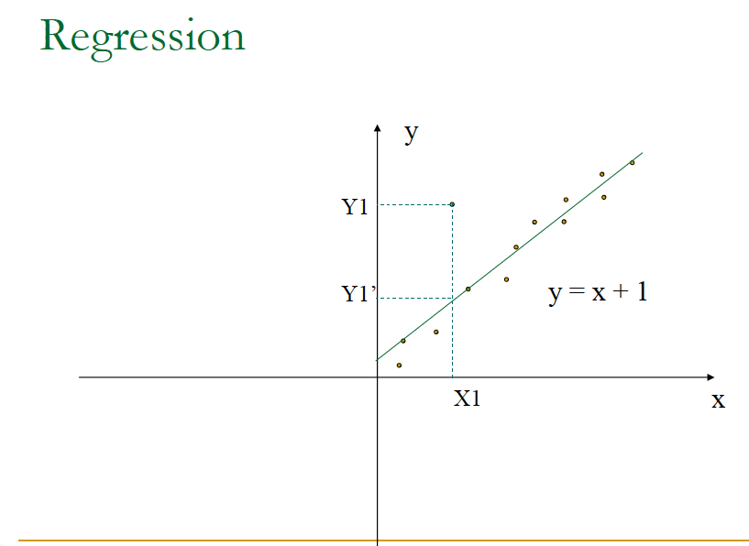

Slide 15
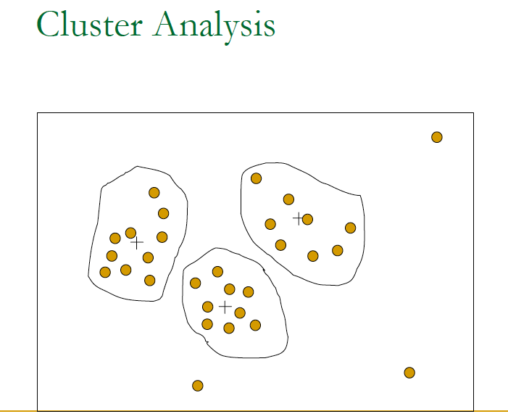

Slide 16
Chapter 3: Data Preprocessing
Data Preprocessing: An Overview
  Data Quality
  Major Tasks in Data Preprocessing
Data Cleaning
Data Integration
Data Reduction
Data Transformation and Data Discretization
Summary

Slide 17
Data Integration
Data integration:
  Combines data from multiple sources into a coherent store
Schema integration: e.g., A.cust-id ≡ B.cust-#
  Integrate metadata from different sources
Entity identification problem:
  Identify real world entities from multiple data sources, e.g., Bill Clinton = William Clinton
Detecting and resolving data value conflicts
  For the same real world entity, attribute values from different sources are different
  Possible reasons: different representations, different scales, e.g., metric vs. British units

Slide 18
Handling Redundancy in Data Integration
Redundant data occur often when integration of multiple databases
  Object identification: The same attribute or object may have different names in different databases
  Derivable data: One attribute may be a “derived” attribute in another table, e.g., annual revenue
Redundant attributes may be able to be detected by correlation analysis and covariance analysis
Careful integration of the data from multiple sources may help reduce/avoid redundancies and inconsistencies and improve mining speed and quality

Slide 19

Correlation Analysis (Nominal Data)
Χ² (chi-square) test
The larger the Χ² value, the more likely the variables are related
The cells that contribute the most to the Χ² value are those whose actual count is very different from the expected count
Correlation does not imply causality
  # of hospitals and # of car-theft in a city are correlated
  Both are causally linked to the third variable: population

Slide 20
Chi-Square Calculation: An Example
Χ² (chi-square) calculation (numbers in parenthesis are expected counts calculated based on the data distribution in the two categories)
It shows that like_science_fiction and play_chess are correlated in the group
 | Play chess | Not play chess | Sum (row)
Like science fiction | 250(90) | 200(360) | 450
Not like science fiction | 50(210) | 1000(840) | 1050
Sum(col.) | 300 | 1200 | 1500

Slide 21



Correlation Analysis (Numeric Data)
Correlation coefficient (also called Pearson’s product moment coefficient)
  where n is the number of tuples, and are the respective means of A and B, σ_{A} and σ_{B} are the respective standard deviation of A and B, and Σ(a_{i}b_{i}) is the sum of the AB cross-product.
If r_{A,B} > 0, A and B are positively correlated (A’s values increase as B’s). The higher, the stronger correlation.
r_{A,B} = 0: independent; r_{AB} < 0: negatively correlated

Slide 22

Visually Evaluating Correlation
Scatter plots showing the similarity from –1 to 1.

Slide 23



Correlation (viewed as linear relationship)
Correlation measures the linear relationship between objects
To compute correlation, we standardize data objects, A and B, and then take their dot product

Slide 24


Covariance (Numeric Data)
Covariance is similar to correlation
  where n is the number of tuples, and are the respective mean or expected values of A and B, σ_{A} and σ_{B} are the respective standard deviation of A and B.
Positive covariance: If Cov_{A,B} > 0, then A and B both tend to be larger than their expected values.
Negative covariance: If Cov_{A,B} < 0 then if A is larger than its expected value, B is likely to be smaller than its expected value.
Independence: Cov_{A,B} = 0 but the converse is not true:
  Some pairs of random variables may have a covariance of 0 but are not independent. Only under some additional assumptions (e.g., the data follow multivariate normal distributions) does a covariance of 0 imply independence
Correlation coefficient:

Slide 25

Co-Variance: An Example
It can be simplified in computation as
Suppose two stocks A and B have the following values in one week: (2, 5), (3, 8), (5, 10), (4, 11), (6, 14).
Question: If the stocks are affected by the same industry trends, will their prices rise or fall together?
  E(A) = (2 + 3 + 5 + 4 + 6)/ 5 = 20/5 = 4
  E(B) = (5 + 8 + 10 + 11 + 14) /5 = 48/5 = 9.6
  Cov(A,B) = (2×5+3×8+5×10+4×11+6×14)/5 − 4 × 9.6 = 4
Thus, A and B rise together since Cov(A, B) > 0.

Slide 26
Chapter 3: Data Preprocessing
Data Preprocessing: An Overview
  Data Quality
  Major Tasks in Data Preprocessing
Data Cleaning
Data Integration
Data Reduction
Data Transformation and Data Discretization
Summary

Slide 27
Data Reduction Strategies
Data reduction: Obtain a reduced representation of the data set that is much smaller in volume but yet produces the same (or almost the same) analytical results
Why data reduction? — A database/data warehouse may store terabytes of data. Complex data analysis may take a very long time to run on the complete data set.
Data reduction strategies
  Dimensionality reduction, e.g., remove unimportant attributes
    Wavelet transforms
    Principal Components Analysis (PCA)
    Feature subset selection, feature creation
  Numerosity reduction (some simply call it: Data Reduction)
    Regression and Log-Linear Models
    Histograms, clustering, sampling
    Data cube aggregation
  Data compression

Slide 28
Data Reduction 1: Dimensionality Reduction
Curse of dimensionality
  When dimensionality increases, data becomes increasingly sparse
  Density and distance between points, which is critical to clustering, outlier analysis, becomes less meaningful
  The possible combinations of subspaces will grow exponentially
Dimensionality reduction
  Avoid the curse of dimensionality
  Help eliminate irrelevant features and reduce noise
  Reduce time and space required in data mining
  Allow easier visualization
Dimensionality reduction techniques
  Wavelet transforms
  Principal Component Analysis
  Supervised and nonlinear techniques (e.g., feature selection)

Slide 29
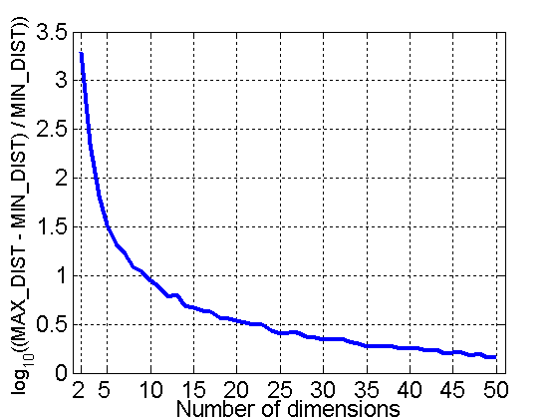
Curse of Dimensionality
When dimensionality increases, data becomes increasingly sparse in the space that it occupies
Definitions of density and distance between points, which is critical for clustering and outlier detection, become less meaningful
Randomly generate 500 points
Compute difference between max and min distance between any pair of points
Introduction to Data Mining by Tan, Steinbach, Kumar (2004)

Slide 30



Mapping Data to a New Space
Fourier transform
Wavelet transform
Two Sine Waves
Two Sine Waves + Noise
Frequency

Slide 31
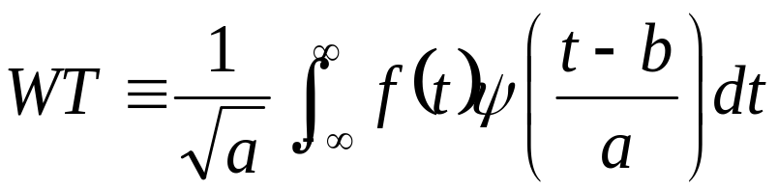
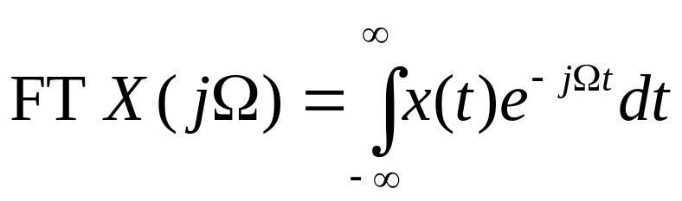
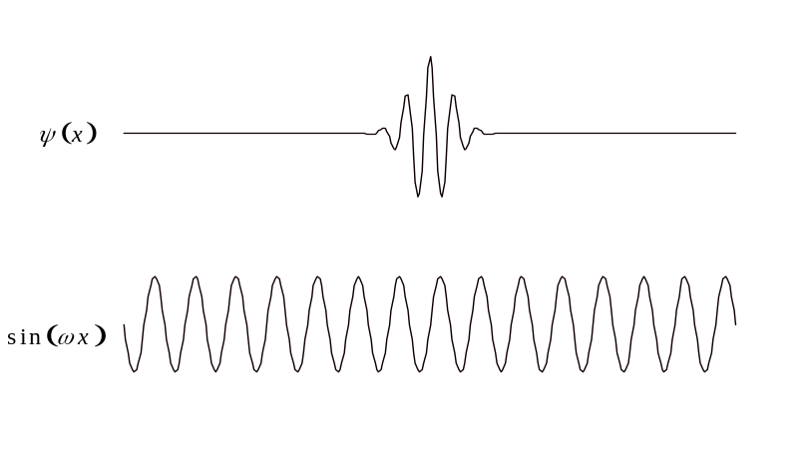
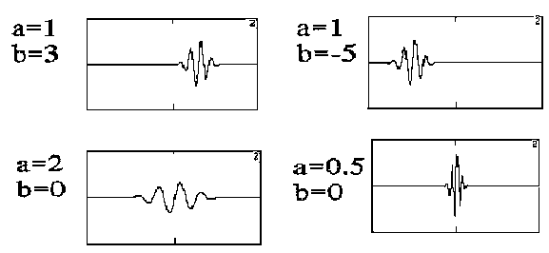
Wavelet Transform
Where a is scale factor, b is time shift
Notes:
FT decomposes signal into sines and cosines
WT

Slide 32

What Is Wavelet Transform?
Decomposes a signal into different frequency subbands
  Applicable to n-dimensional signals
Data are transformed to preserve relative distance between objects at different levels of resolution
Allow natural clusters to become more distinguishable
Used for image compression

Slide 33
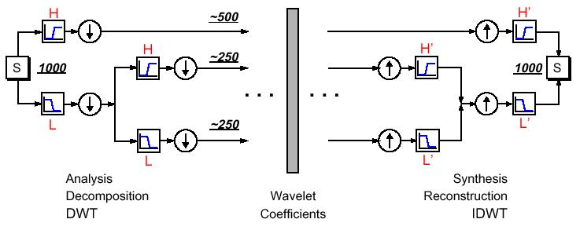
Successive Wavelet/Subband Decomposition
UMCP ENEE631 Slides (created by M.Wu © 2001/2004)
  Successive lowpass/highpass filtering and downsampling
    on different level: capture transitions of different frequency bands
    on the same level: capture transitions at different locations
Figure from Matlab Wavelet Toolbox Documentation
ENEE631 Digital Image Processing (Spring'04)
Lec14 – Wavelet Coding [<number>]

Slide 34
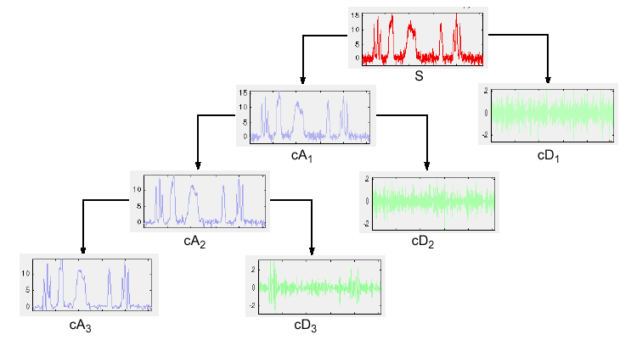
Examples of 1-D Wavelet Transform
UMCP ENEE631 Slides (created by M.Wu © 2001)
From Matlab Wavelet Toolbox Documentation
Lec14 – Wavelet Coding [<number>]
ENEE631 Digital Image Processing (Spring'04)

Slide 35
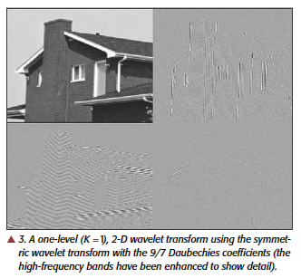
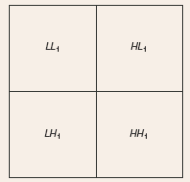
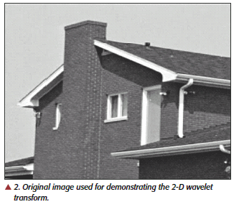
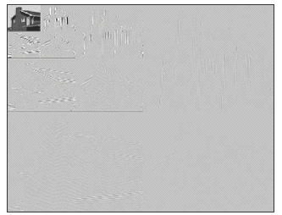
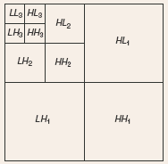
2-D Example
UMCP ENEE631 Slides (created by M.Wu © 2004)
From Usevitch (IEEE Sig.Proc. Mag. 9/01)
ENEE631 Digital Image Processing (Spring'04)
Lec14 – Wavelet Coding [<number>]

Slide 36
Wavelet Transformation
Haar2
Daubechie4
Discrete wavelet transform (DWT) for linear signal processing, multi-resolution analysis
Compressed approximation: store only a small fraction of the strongest of the wavelet coefficients
Similar to discrete Fourier transform (DFT), but better lossy compression, localized in space
Method:
  Length, L, must be an integer power of 2 (padding with 0’s, when necessary)
  Each transform has 2 functions: smoothing, difference
  Applies to pairs of data, resulting in two set of data of length L/2
  Applies two functions recursively, until reaches the desired length

Slide 37
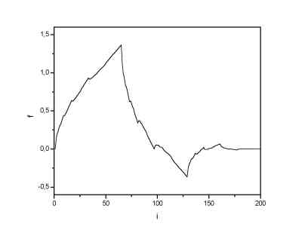
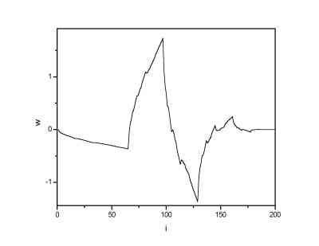
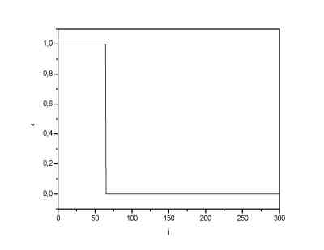
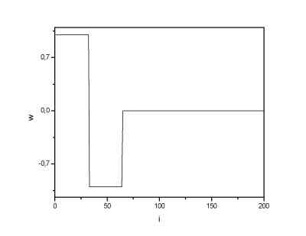
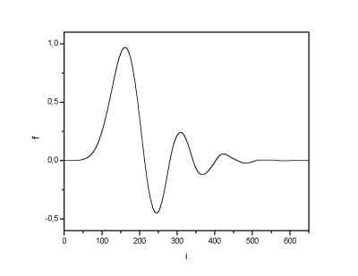
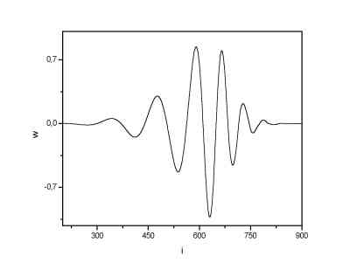
Wavelets
Daubechies 4 wavelet
Harr wavelet
Daubechies 20 wavelet
Notes:
The most known family of orthonormal wavelets is a family of Daubechies. Her wavelets are usually denominated by the number of nonzero coefficients a_k, so we usually talk about Daubechies 4, Daubechies 6 etc.

Slide 38
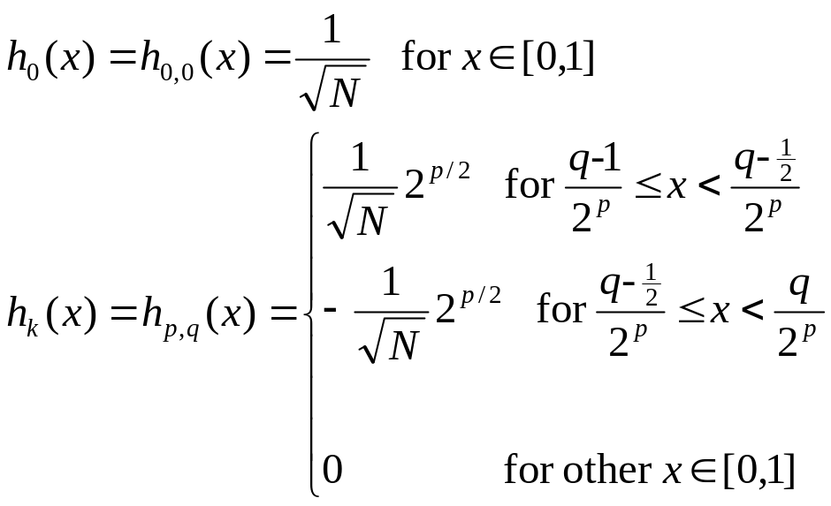
Construction of Haar functions
Unique decomposition of integer k ⬄ (p, q)
  k = 0, …, N-1 with N = 2^{n}, 0 <= p <= n-1
  q = 0, 1 (for p=0); 1 <= q <= 2^{p} (for p>0)
  e.g., k=0 k=1 k=2 k=3 k=4 …
  (0,0) (0,1) (1,1) (1,2) (2,1) …
h_{k}(x) = h _{p,q}(x) for x ∈ [0,1]
power of 2
k = 2^{p} + q – 1
“reminder”
UMCP ENEE631 Slides (created by M.Wu © 2001/2004)
x
1
Lec14 – Wavelet Coding [<number>]
ENEE631 Digital Image Processing (Spring'04)

Slide 39

Wavelet Decomposition
Wavelets: A math tool for space-efficient hierarchical decomposition of functions
S = [2, 2, 0, 2, 3, 5, 4, 4] can be transformed to S^ = [2³/₄, -1¹/₄, ¹/₂, 0, 0, -1, -1, 0]
Compression: many small detail coefficients can be replaced by 0’s, and only the significant coefficients are retained

Slide 40
Haar Wavelet Coefficients
Coefficient “Supports”
₊
Hierarchical decomposition structure (a.k.a. “error tree”)
2.75
₋
2.75
₊
+
-1.25
₋
+
-1.25
-
₊
0.5
₋
0.5
0
₊
+
-
+
-
0
₋
0
-1
-1
0
₊
0
₋
+
-
+
-
+
-
+
-
₊
₋
-1
2 2 0 2 3 5 4 4
₊
-1
₋
₊
Original frequency distribution
0

Slide 41
Why Wavelet Transform?
Use hat-shape filters
  Emphasize region where points cluster
  Suppress weaker information in their boundaries
Effective removal of outliers
  Insensitive to noise, insensitive to input order
Multi-resolution
  Detect arbitrary shaped clusters at different scales
Efficient
  Complexity O(N)
Only applicable to low dimensional data

Slide 42
Principal Component Analysis (PCA)
Find a projection that captures the largest amount of variation in data
The original data are projected onto a much smaller space, resulting in dimensionality reduction. We find the eigenvectors of the covariance matrix, and these eigenvectors define the new space
x₂
e
x₁

Slide 43
Principal Component Analysis (Steps)
Given N data vectors from n-dimensions, find k ≤ n orthogonal vectors (principal components) that can be best used to represent data
  Normalize input data: Each attribute falls within the same range
  Compute k orthonormal (unit) vectors, i.e., principal components
  Each input data (vector) is a linear combination of the k principal component vectors
  The principal components are sorted in order of decreasing “significance” or strength
  Since the components are sorted, the size of the data can be reduced by eliminating the weak components, i.e., those with low variance (i.e., using the strongest principal components, it is possible to reconstruct a good approximation of the original data)
Works for numeric data only

Slide 44
Attribute Subset Selection
Another way to reduce dimensionality of data
Redundant attributes
  Duplicate much or all of the information contained in one or more other attributes
  E.g., purchase price of a product and the amount of sales tax paid
Irrelevant attributes
  Contain no information that is useful for the data mining task at hand
  E.g., students' ID is often irrelevant to the task of predicting students' GPA

Slide 45
Heuristic Search in Attribute Selection
There are 2^{d} possible attribute combinations of d attributes
Typical heuristic attribute selection methods:
  Best single attribute under the attribute independence assumption: choose by significance tests
  Best step-wise feature selection:
    The best single-attribute is picked first
    Then next best attribute condition to the first, ...
  Step-wise attribute elimination:
    Repeatedly eliminate the worst attribute
  Best combined attribute selection and elimination
  Optimal branch and bound:
    Use attribute elimination and backtracking

Slide 46
Attribute Creation (Feature Generation)
Create new attributes (features) that can capture the important information in a data set more effectively than the original ones
Three general methodologies
  Attribute extraction
    Domain-specific
  Mapping data to new space (see: data reduction)
    E.g., Fourier transformation, wavelet transformation, manifold approaches (not covered)
  Attribute construction
    Combining features (see: discriminative frequent patterns in Chapter 7)
    Data discretization

Slide 47
Data Reduction 2: Numerosity Reduction
Reduce data volume by choosing alternative, smaller forms of data representation
Parametric methods (e.g., regression)
  Assume the data fits some model, estimate model parameters, store only the parameters, and discard the data (except possible outliers)
  Ex.: Log-linear models—obtain value at a point in m-D space as the product on appropriate marginal subspaces
Non-parametric methods
  Do not assume models
  Major families: histograms, clustering, sampling, …

Slide 48
Parametric Data Reduction: Regression and Log-Linear Models
Linear regression
  Data modeled to fit a straight line
  Often uses the least-square method to fit the line
Multiple regression
  Allows a response variable Y to be modeled as a linear function of multidimensional feature vector
Log-linear model
  Approximates discrete multidimensional probability distributions

Slide 49
Regression Analysis
y
Y1
Regression analysis: A collective name for techniques for the modeling and analysis of numerical data consisting of values of a dependent variable (also called response variable or measurement) and of one or more independent variables (aka. explanatory variables or predictors)
The parameters are estimated so as to give a "best fit" of the data
Most commonly the best fit is evaluated by using the least squares method, but other criteria have also been used
Y1’
y = x + 1
X1
x
Used for prediction (including forecasting of time-series data), inference, hypothesis testing, and modeling of causal relationships

Slide 50
Regress Analysis and Log-Linear Models
Linear regression: Y = w X + b
  Two regression coefficients, w and b, specify the line and are to be estimated by using the data at hand
  Using the least squares criterion to the known values of Y₁, Y₂, …, X₁, X₂, ….
Multiple regression: Y = b₀ + b₁ X₁ + b₂ X₂
  Many nonlinear functions can be transformed into the above
Log-linear models:
  Approximate discrete multidimensional probability distributions
  Estimate the probability of each point (tuple) in a multi-dimensional space for a set of discretized attributes, based on a smaller subset of dimensional combinations
  Useful for dimensionality reduction and data smoothing

Slide 51

Histogram Analysis
Divide data into buckets and store average (sum) for each bucket
Partitioning rules:
  Equal-width: equal bucket range
  Equal-frequency (or equal-depth)

Slide 52
Clustering
Partition data set into clusters based on similarity, and store cluster representation (e.g., centroid and diameter) only
Can be very effective if data is clustered but not if data is “smeared”
Can have hierarchical clustering and be stored in multi-dimensional index tree structures
There are many choices of clustering definitions and clustering algorithms
Cluster analysis will be studied in depth in Chapter 10

Slide 53
Sampling
Sampling: obtaining a small sample s to represent the whole data set N
Allow a mining algorithm to run in complexity that is potentially sub-linear to the size of the data
Key principle: Choose a representative subset of the data
  Simple random sampling may have very poor performance in the presence of skew
  Develop adaptive sampling methods, e.g., stratified sampling:
Note: Sampling may not reduce database I/Os (page at a time)

Slide 54
Types of Sampling
Simple random sampling
  There is an equal probability of selecting any particular item
Sampling without replacement
  Once an object is selected, it is removed from the population
Sampling with replacement
  A selected object is not removed from the population
Stratified sampling:
  Partition the data set, and draw samples from each partition (proportionally, i.e., approximately the same percentage of the data)
  Used in conjunction with skewed data

Slide 55
Sampling: With or without Replacement
SRSWOR
(simple random
sample without
replacement)
SRSWR
Raw Data

Slide 56
Sampling: Cluster or Stratified Sampling
Raw Data
Cluster/Stratified Sample

Slide 57
Aggregation
Combining two or more attributes (or objects) into a single attribute (or object)
Purpose
  Data reduction
    Reduce the number of attributes or objects
  Change of scale
    Cities aggregated into regions, states, countries, etc
  More “stable” data
    Aggregated data tends to have less variability
Data Mining: Concepts and Techniques @Tan, Steinbach, Kumar

Slide 58
Data Cube Aggregation
The lowest level of a data cube (base cuboid)
  The aggregated data for an individual entity of interest
  E.g., a customer in a phone calling data warehouse
Multiple levels of aggregation in data cubes
  Further reduce the size of data to deal with
Reference appropriate levels
  Use the smallest representation which is enough to solve the task
Queries regarding aggregated information should be answered using data cube, when possible

Slide 59
Data Reduction 3: Data Compression
String compression
  There are extensive theories and well-tuned algorithms
  Typically lossless, but only limited manipulation is possible without expansion
Audio/video compression
  Typically lossy compression, with progressive refinement
  Sometimes small fragments of signal can be reconstructed without reconstructing the whole
Time sequence is not audio
  Typically short and vary slowly with time
Dimensionality and numerosity reduction may also be considered as forms of data compression

Slide 60
Data Compression
Original Data
Compressed
Data
lossless
Original Data
Approximated
lossy

Slide 61
Chapter 3: Data Preprocessing
Data Preprocessing: An Overview
  Data Quality
  Major Tasks in Data Preprocessing
Data Cleaning
Data Integration
Data Reduction
Data Transformation and Data Discretization
Summary

Slide 62
Data Transformation
A function that maps the entire set of values of a given attribute to a new set of replacement values s.t. each old value can be identified with one of the new values
Methods
  Smoothing: Remove noise from data
  Attribute/feature construction
    New attributes constructed from the given ones
  Aggregation: Summarization, data cube construction
  Normalization: Scaled to fall within a smaller, specified range
    min-max normalization
    z-score normalization
    normalization by decimal scaling

Slide 63





Normalization
Min-max normalization: to [new_min_{A}, new_max_{A}]
  Ex. Let income range $12,000 to $98,000 normalized to [0.0, 1.0]. Then $73,000 is mapped to
Z-score normalization (μ: mean, σ: standard deviation):
  Ex. Let μ = 54,000, σ = 16,000. Then
Normalization by decimal scaling
Where j is the smallest integer such that Max(|ν’|) < 1

Slide 64
Discretization
Three types of attributes
  Nominal—values from an unordered set, e.g., color, profession
  Ordinal—values from an ordered set, e.g., military or academic rank
  Numeric—real numbers, e.g., integer or real numbers
Discretization: Divide the range of a continuous attribute into intervals
  Interval labels can then be used to replace actual data values
  Reduce data size by discretization
  Supervised vs. unsupervised
  Split (top-down) vs. merge (bottom-up)
  Discretization can be performed recursively on an attribute
  Prepare for further analysis, e.g., classification

Slide 65
Data Discretization Methods
Typical methods: All the methods can be applied recursively
  Binning
    Top-down split, unsupervised
  Histogram analysis
    Top-down split, unsupervised
  Clustering analysis (unsupervised, top-down split or bottom-up merge)
  Decision-tree analysis (supervised, top-down split)
  Correlation (e.g., χ²) analysis (unsupervised, bottom-up merge)

Slide 66




Discretization Without Using Class Labels
(Binning vs. Clustering)
Data
Equal interval width (binning)
Equal frequency (binning)
K-means clustering leads to better results

Slide 67
Discretization by Classification & Correlation Analysis
Classification (e.g., decision tree analysis)
  Supervised: Given class labels, e.g., cancerous vs. benign
  Using entropy to determine split point (discretization point)
  Top-down, recursive split
  Details to be covered in Chapter 7
Correlation analysis (e.g., Chi-merge: χ²-based discretization)
  Supervised: use class information
  Bottom-up merge: find the best neighboring intervals (those having similar distributions of classes, i.e., low χ² values) to merge
  Merge performed recursively, until a predefined stopping condition

Slide 68
Chapter 3: Data Preprocessing
Data Preprocessing: An Overview
  Data Quality
  Major Tasks in Data Preprocessing
Data Cleaning
Data Integration
Data Reduction
Data Transformation and Data Discretization
Summary

Slide 69
Summary
Data quality: accuracy, completeness, consistency, timeliness, believability, interpretability
Data cleaning: e.g. missing/noisy values, outliers
Data integration from multiple sources:
  Entity identification problem
  Remove redundancies
  Detect inconsistencies
Data reduction
  Dimensionality reduction
  Numerosity reduction
  Data compression
Data transformation and data discretization
  Normalization
  Discretization

Slide 70
References
D. P. Ballou and G. K. Tayi. Enhancing data quality in data warehouse environments. Comm. of ACM, 42:73-78, 1999
A. Bruce, D. Donoho, and H.-Y. Gao. Wavelet analysis. IEEE Spectrum, Oct 1996
T. Dasu and T. Johnson. Exploratory Data Mining and Data Cleaning. John Wiley, 2003
J. Devore and R. Peck. Statistics: The Exploration and Analysis of Data. Duxbury Press, 1997.
H. Galhardas, D. Florescu, D. Shasha, E. Simon, and C.-A. Saita. Declarative data cleaning: Language, model, and algorithms. VLDB'01
M. Hua and J. Pei. Cleaning disguised missing data: A heuristic approach. KDD'07
H. V. Jagadish, et al., Special Issue on Data Reduction Techniques. Bulletin of the Technical Committee on Data Engineering, 20(4), Dec. 1997
H. Liu and H. Motoda (eds.). Feature Extraction, Construction, and Selection: A Data Mining Perspective. Kluwer Academic, 1998
J. E. Olson. Data Quality: The Accuracy Dimension. Morgan Kaufmann, 2003
D. Pyle. Data Preparation for Data Mining. Morgan Kaufmann, 1999
V. Raman and J. Hellerstein. Potters Wheel: An Interactive Framework for Data Cleaning and Transformation, VLDB’2001
T. Redman. Data Quality: The Field Guide. Digital Press (Elsevier), 2001
R. Wang, V. Storey, and C. Firth. A framework for analysis of data quality research. IEEE Trans. Knowledge and Data Engineering, 7:623-640, 1995

